Slide 1


Citizen Engagement
POSC 509
Foundations of Public Administration

Slide 2

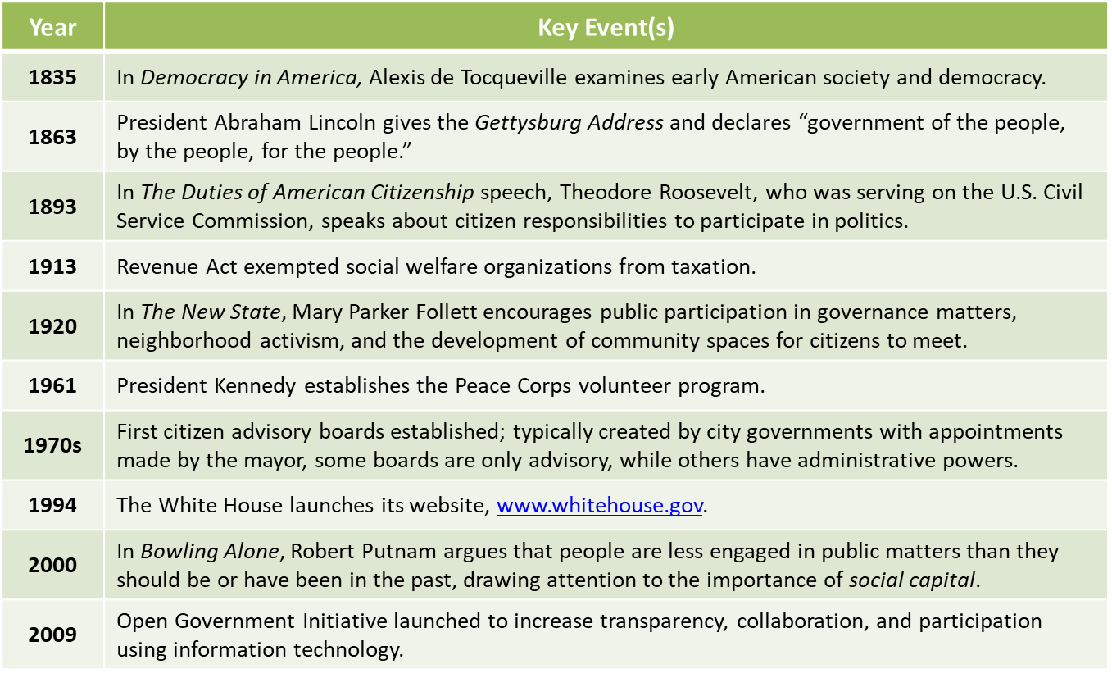
Timeline

Slide 3
Preview
Why citizen engagement matters
Forms of engagement
Coproduction
Soliciting viewpoints

Slide 4
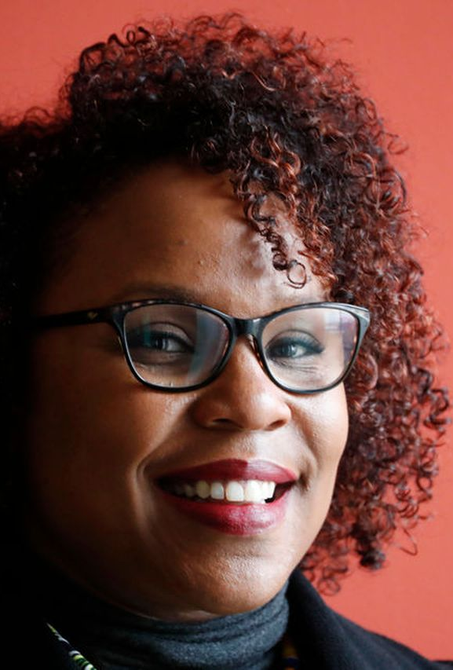
In my own words
“[We] galvanize citizens to increase equitable civic engagement, democracy building, voter participation, and efforts for fair elections.”
- Erika Anthony, MPA, Executive Director of Ohio Transformation Fund

Slide 5
Citizen Engagement
Defined: The active engagement of citizens in pursuit of public purposes.
Law enforcement cannot enforce unless citizens respect the law.
Schools cannot educate in the absence of a readiness to learn.
Government cannot provide services without adequate resources.
Civil relationships do not develop in the absence of respect for one another.

Slide 6

Classic Civic Engagement: Jane Addams

Slide 7
Citizen Engagement: The Good, the Bad, and the ugly
How can administrators differentiate constructive versus destructive engagement?
What is the best way to engage those who are disaffected?
What management components contribute to civil discourse as grievances are aired?

Slide 8

Regime Values and Political Theory
Life, Liberty, Property (or pursuit of happiness)
and seven related regime values
Political Theory
Development over time, from Ancient Greeks to Modern Day
“Public Administration is the vehicle for implementing the values of individuals and communities.”
These values are expressed through politics

Slide 9
Why citizen engagement matters
To practice democratic principles and citizenship behavior..
To create resilient communities.
To build commitment for programs.
To enlist coproduction
To develop creative solutions to public problems.
To avoid policy failure.
To keep public processes and services tightly linked to the people being served.

Slide 10
To practice democratic principles and citizenship behavior
People involve themselves in government decisions and delivery and evaluation of public services through representative democracy.
Forms of representation include:
Elected lawmakers, e.g., councilpersons, board members, commissioners, congresspersons
Elected executives, e.g., mayors, governors, president
Appointed office-holders, e.g., agency heads
Public interest groups

Slide 11
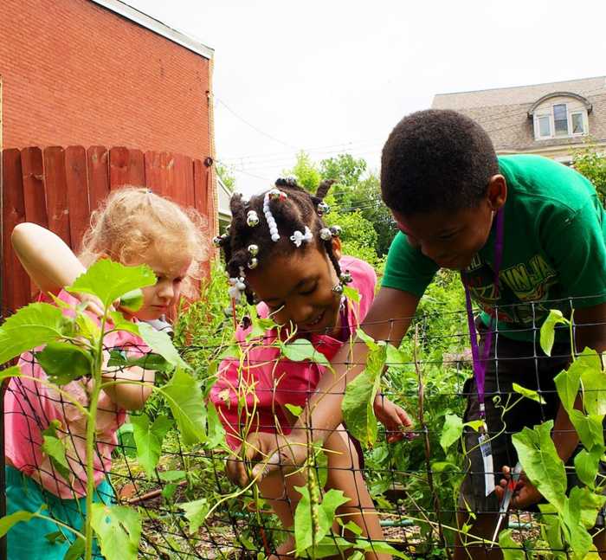
To Create Resilient Communities
Resilience refers to the capacity of a community to absorb disturbance and rebuild, literally or figuratively, while undergoing dramatic change.
Community gardens are a great example!

Slide 12
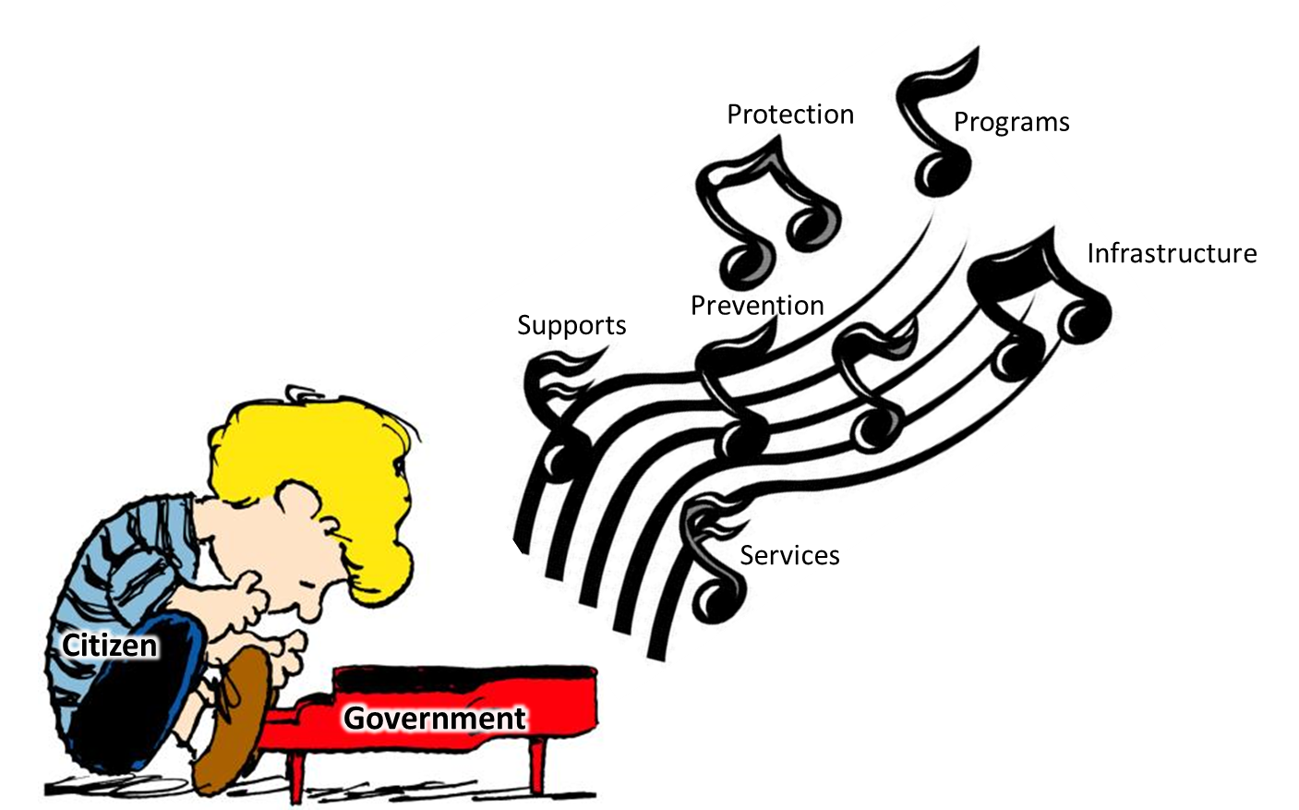
Build commitments for Programs
Government is the instrument citizens use to ensure their safety and secure services that are not provided elsewhere.
Government programs only work well when the public is committed to them.

Slide 13
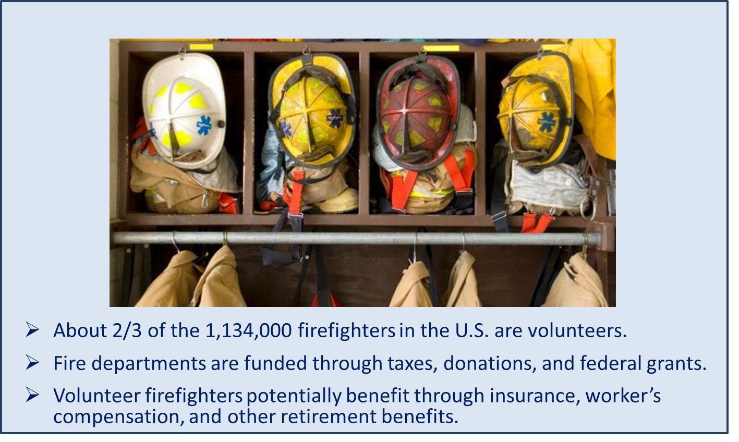
To enlist Coproduction
Coproduction:
Citizen participation and compliance in the execution of government action.

Slide 14
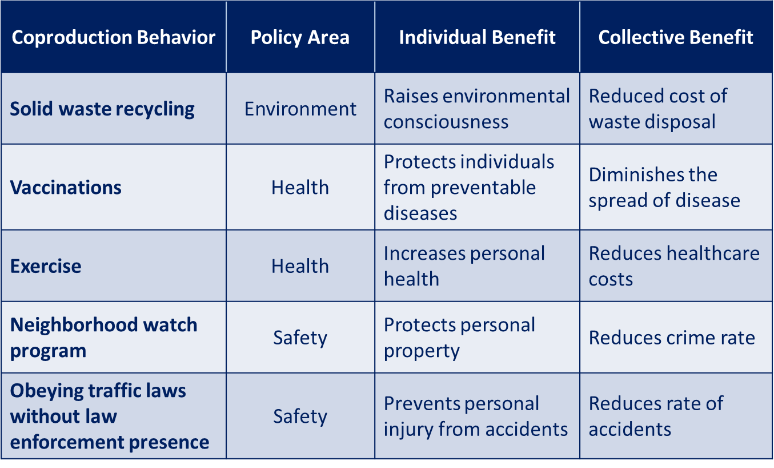
Coproduction benefits individuals and Communities

Slide 15
How do Agency Managers Manage for Coproduction?
Determine most effective type of stakeholder involvement
Use incentives when needed
Appeal to the benefits of participation
Involve citizens with meaningful intention
Make involvement meaningful
Make boundaries clear to citizens

Slide 16

To develop creative solutions to public problems
Example: Protecting Greater Sage-Grouse which were in danger of extinction.
A diverse group of stakeholders including ranchers, environmental groups, tribes, state, county, and city officials, academics, public land users, and the general public collaborated in a multi-state decision making process.
The plan works to save the bird from extinction while avoiding federal regulation that could negatively impact the culture, quality of life, and economy of western communities.
Example: The Sage Grouse Initiative

Slide 17
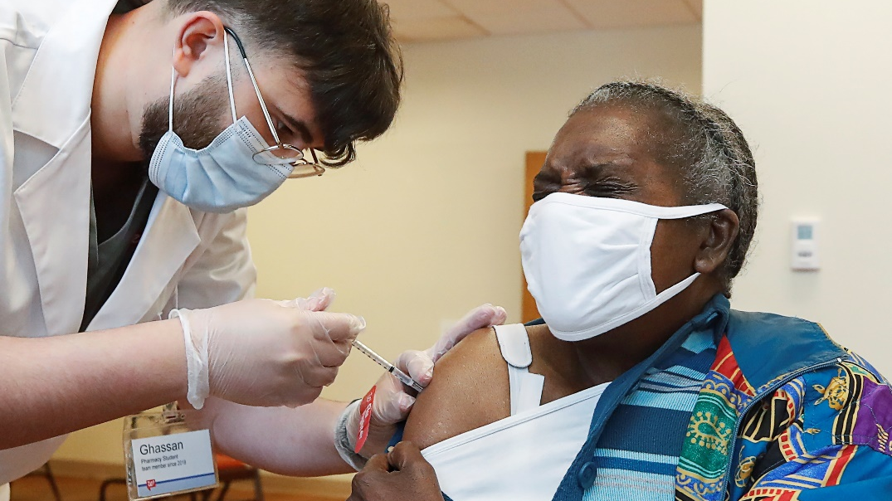
To avoid policy failure
Example: Vaccine Hesitancy Due to Lack of Trust
Despite the ravages of COVID-19, some communities most severely affected by it were hesitant to take advantage of vaccines.
Though such factors as misinformation play a role, vaccine hesitancy often occurs in communities that have historically been harmed by socially irresponsible health programs.
This is especially the case for African Americans due to the Tuskegee syphilis study conducted from 1932 to 1972.

Slide 18
TO Keep public processes and services tightly linked to the people being served
Cynicism diminishes trust in government and makes it harder for public officials to work collaboratively with the public.
Cynicism occurs when the public is not engaged and feels powerless.
A tight linkage between government and people helps to prevent and overcome cynicism.

Slide 19
Forms of Engagement: from the Government to the Public
Public information officers
Strategic planning
Council meetings
Citizen advisory boards
Task forces / citizen review boards / commissions
Neighborhood / town halls / public meetings
Coffee-with-the-mayor meetings
Information and communications technology
Citizen academies
Real-time performance data

Slide 20
Forms of Engagement: From the Public to the Government
Focus groups
Citizen surveys
Nonprofit organizations as vehicles for participation
Social media

Slide 21

The Public as Partner: Managing for Citizen Coproduction and Collaboration
Determine the appropriate tool to increase stakeholder participation.
Use incentives when needed.
Appeal to the benefits of participation.
Intentionally involve others.
Initiate meaningful involvement.
Make boundaries (such as money, time, and feasibility) clear and understandable.
Gather input from and involve citizens to address street-level problems collaboratively.

Slide 22
Citizen Engagement Summary
A democracy relies on its citizens and administration to provide services.
Working together, government and the public join to build stronger communities and solve problems.
Cynicism creates problems of mistrust between the public and the government.
Sustainable collective action takes work to develop and requires robust administrative infrastructure.

Slide 23

For discussion
Describe the challenges to public managers as they solicit community engagement and input.
Describe three forms of citizen engagement available to you in your community.

